Slide 1
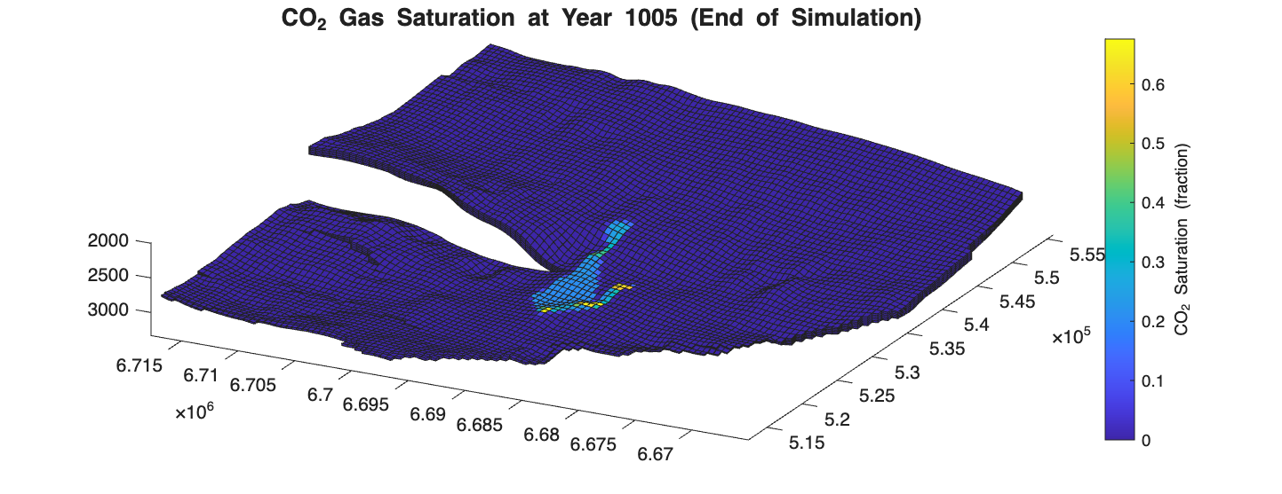
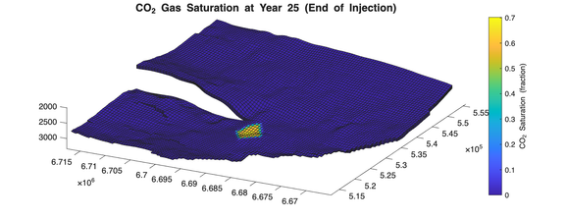
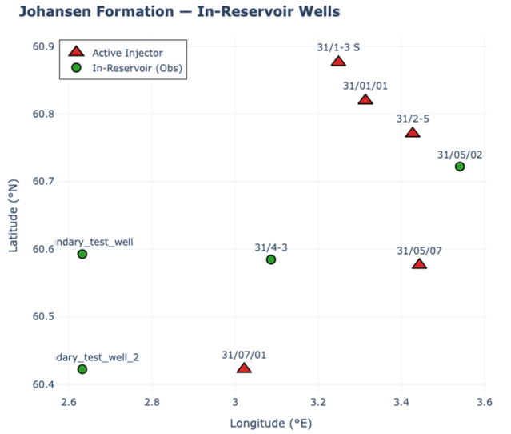
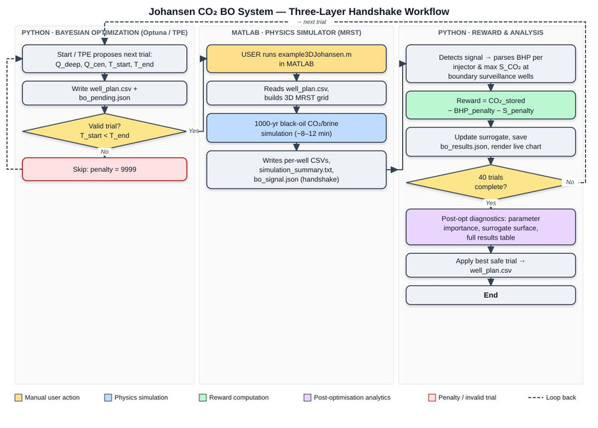
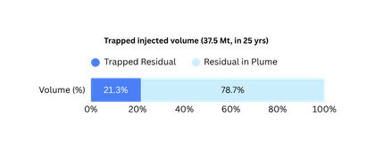
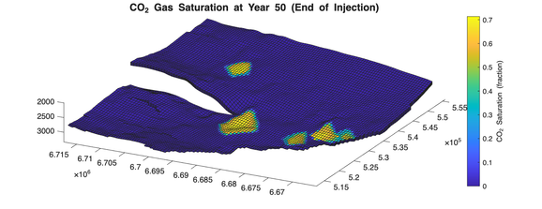
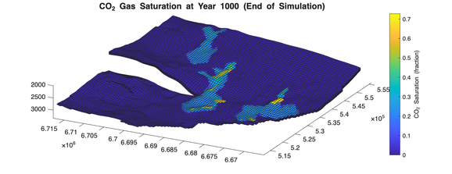
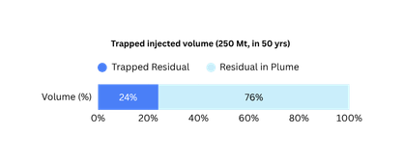
Application of Reservoir and Production Surveillance for Optimized Reservoir Management in Conventional or Unconventional Fields
(Johansen Field Injection Optimisation)
Before:
Only one well was injecting @ 1.5Mt/yr (as per Phase - I) with 6 surveillance wells
Total injection plan 37.5 Mt in 25 yrs.
Proposition:
5 injector and 2 surveillance, 6.875Mt/yr
Total injection plan 250 Mt in 50 yrs.
Constraints:
Overhead Caprock Fracture Pressure (335 bar)
Saturation of CO2 should be < 0.15 (critical CO2 saturation) for Johansen, at boundary
Boundary surveillance data directly gates the next injection proposal — monitoring becomes decision-making.
Containment failure ,pressure breach are penalised, encoding geophysical irreversibility into the reward function.
Two boundary sentinels on opposing plume pathways ensure no unsafe strategy escapes constraint detection.
Staggered inter-cluster injection timing emerges as an optimised pressure management strategy — never prescribed, always discovered.
SIMULATION
OPTIMISATION
Author 1 Name: Parth Shroff (24JE1030)
Author 2 Name: Jai Oza (24JE1010)
Discipline and Year (Pre-final or Final): B.Tech Petroleum Engineering, Pre-final
Notes:
1

